Slide 1
Opening Remarks: Convergence of LLMs and KGs
John Beverley
Assistant Professor, University at Buffalo
Co-Director, National Center for Ontological Research
Affiliate Faculty, Institute of Artificial Intelligence and Data Science

Slide 2
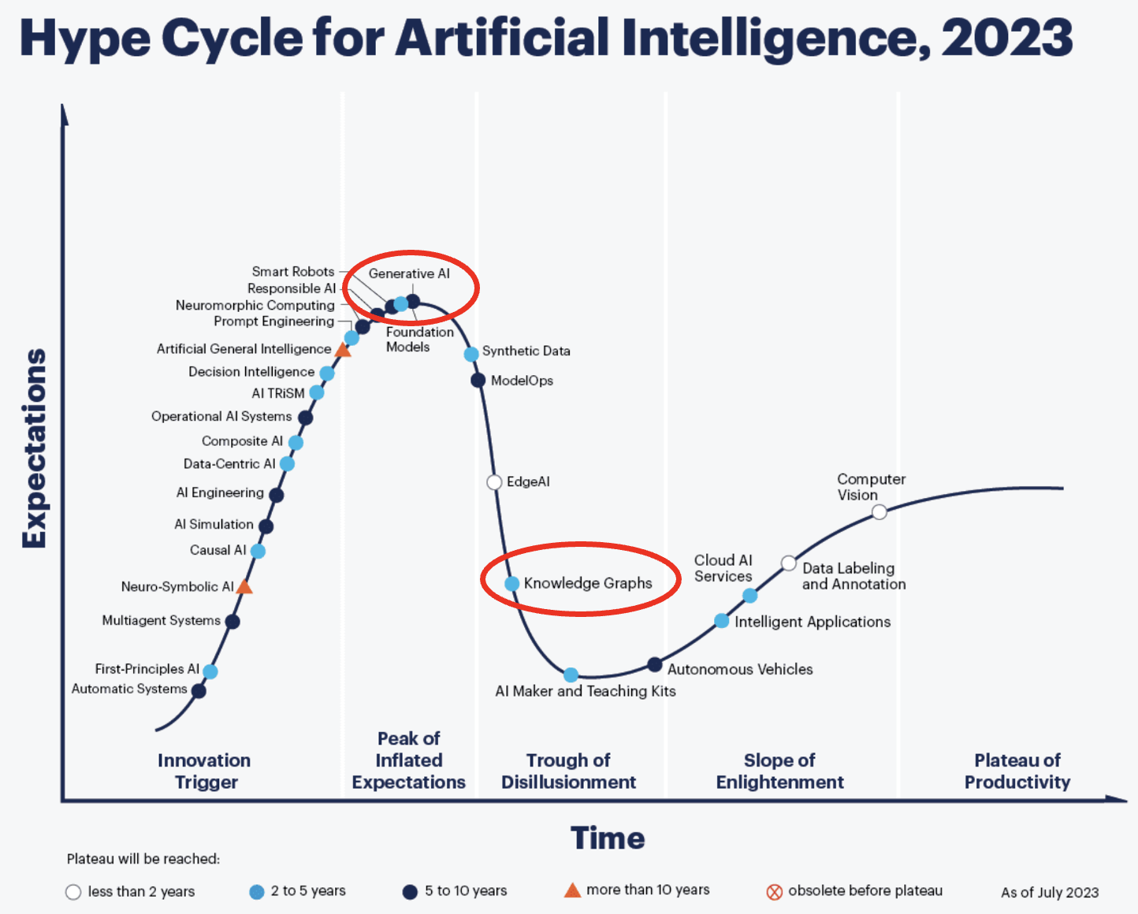
Present Summer
The current summer is one of big data, cheaper & faster computing, generative techniques, knowledge graph integration, and neuro-symbolic systems
But also hype and overpromising

Slide 3
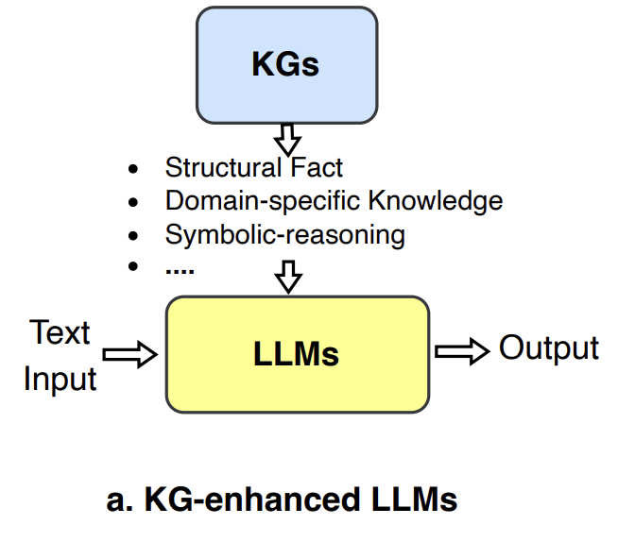
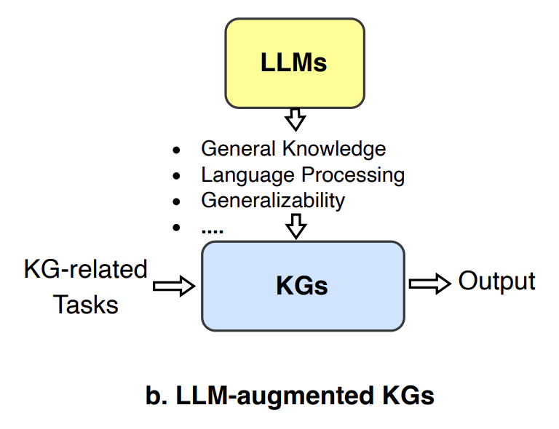
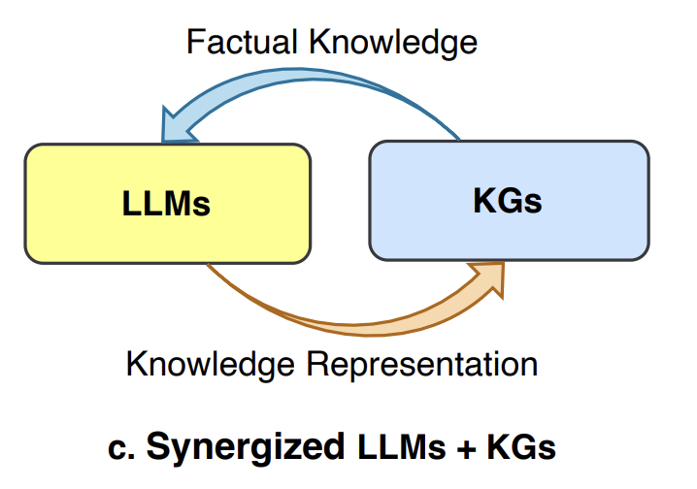
Generative AI
Advances in generative AI can help address concerns raised in modern applications of knowledge graphs
Advances in knowlede representation can help temper expectations and improve the quality of generative AI

Slide 4
Knowledge representation researchers must expand their horizons, learn to integrate existing and novel AI technologies

Slide 5
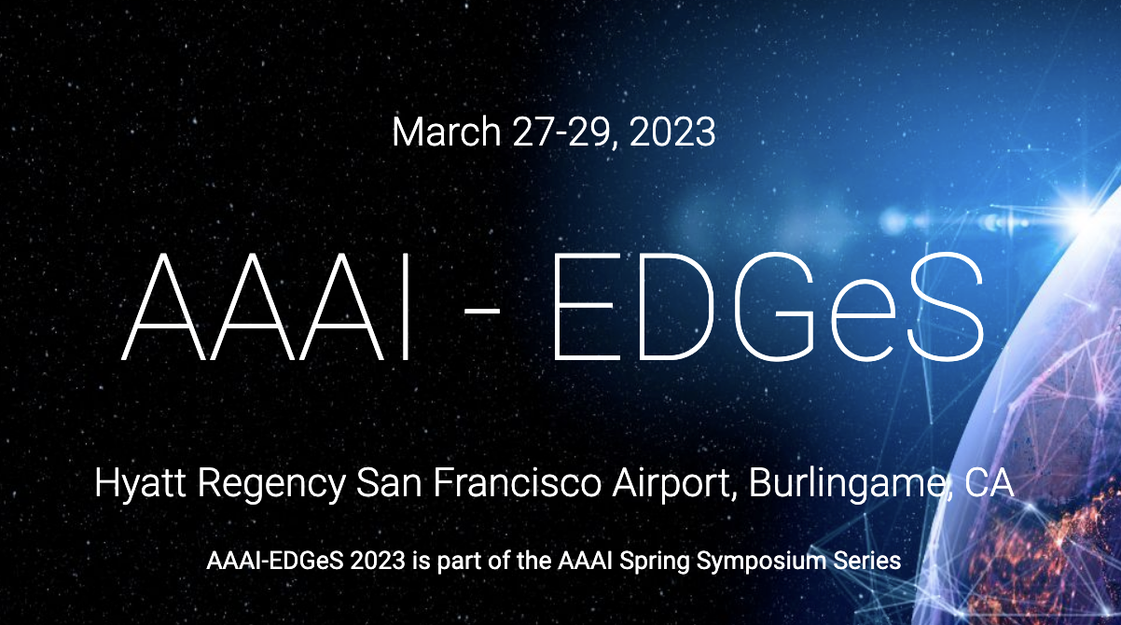

Slide 6
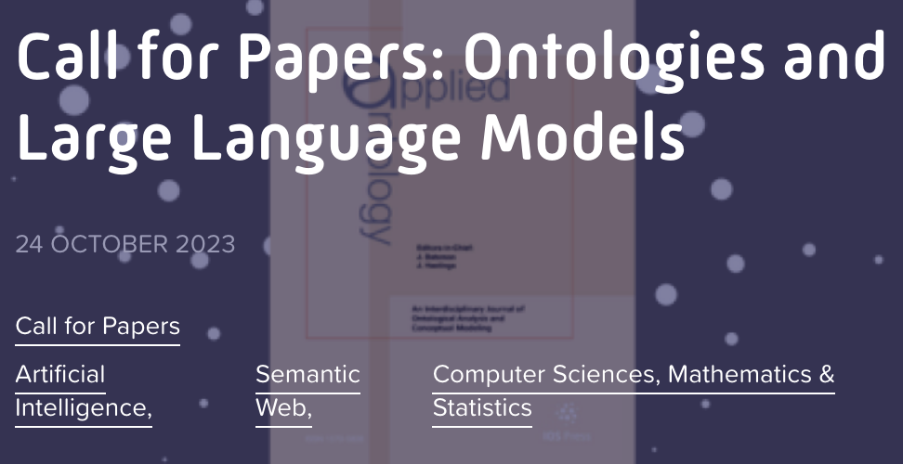
Optimistic Caution
If we are to make good on the promises of knowledge representation and reasoning, we must bring our expertise to the intersection of ontologies, knowledge graphs, and advancees in contemporary AI

Slide 7
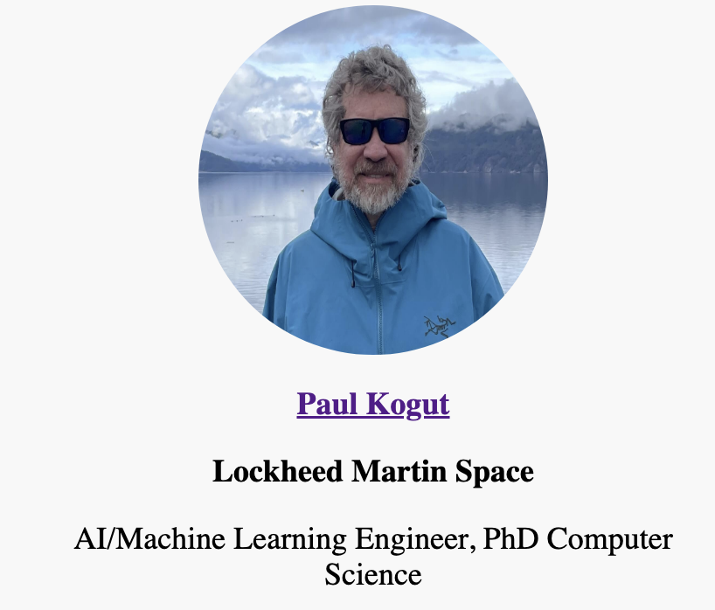

Slide 10
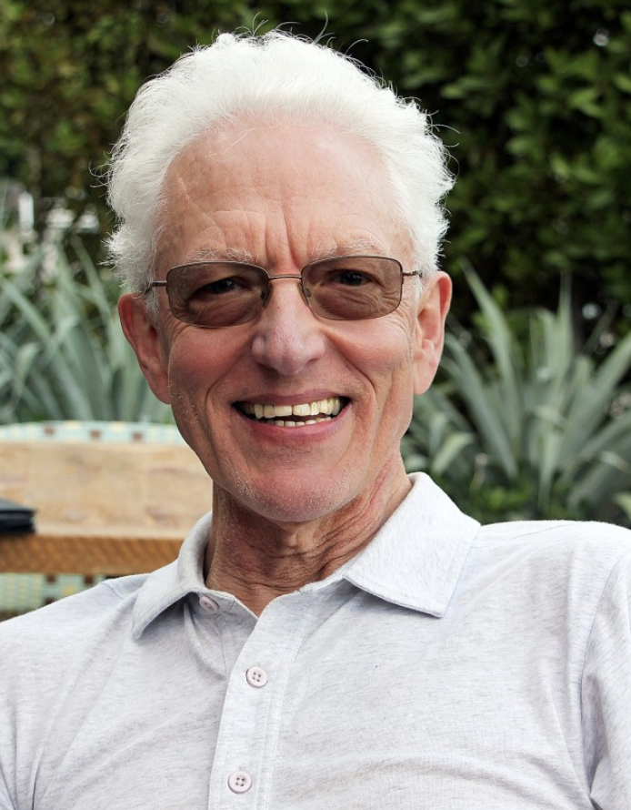
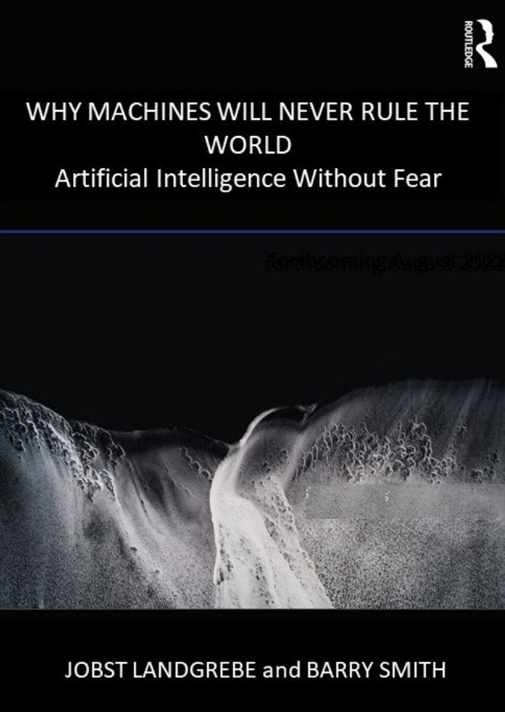
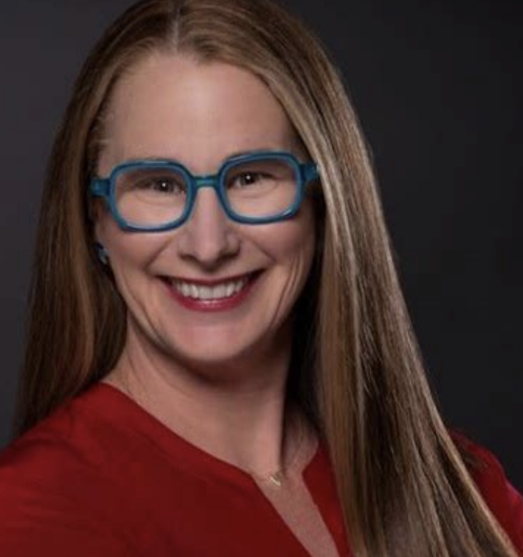
Keynotes
PART 2

